Slide 1
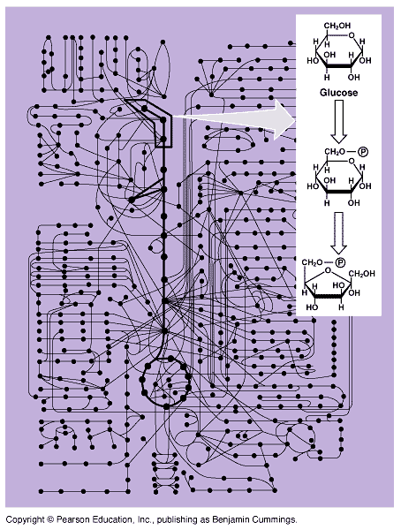
______
Metabolic Energetics

Slide 2
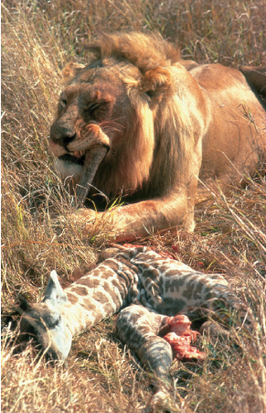

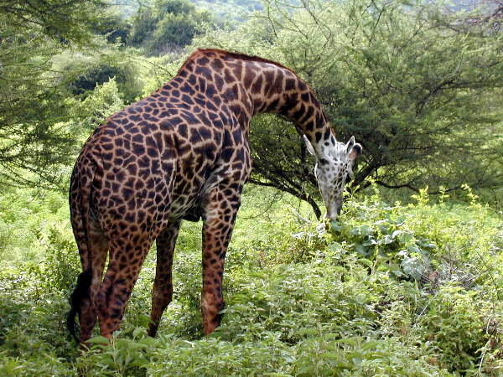
Flow of energy through life
Life is built on chemical reactions
  transforming energy from one form to another
organic molecules → ATP & organic molecules
sun
organic molecules →
ATP & organic molecules
solar energy →
ATP & organic molecules

Slide 3

Metabolism
Chemical reactions of life
  Building molecules
    dehydration synthesis
    endergonic
    anabolic reactions
  Breaking molecules
    Hydrolysis
    Exergonic
    digestion
    catabolic reactions

Slide 4

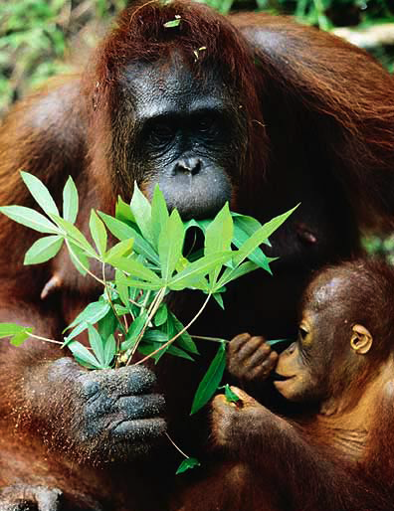
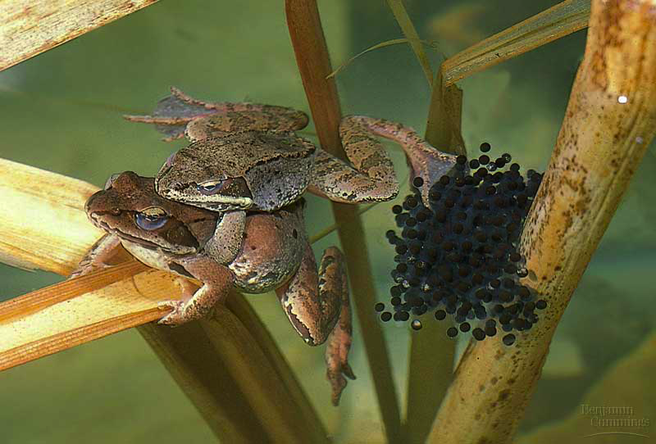

The energy needs of life
Organisms are endergonic systems
  What do we need energy for?
    synthesis
      building biomolecules
    reproduction
    movement
    active transport
    temperature regulation
Notes:
Which is to say… if you don’t eat, you die… because you run out of energy.
The 2nd Law of Thermodynamics takes over!

Slide 5
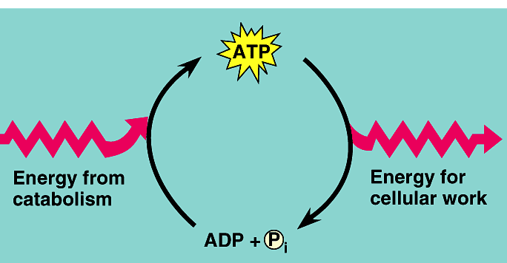
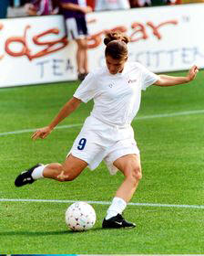
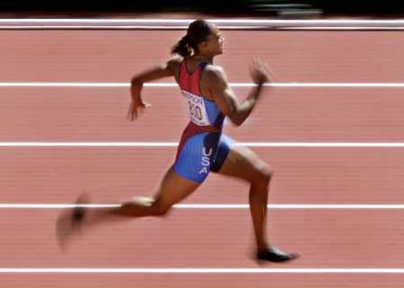
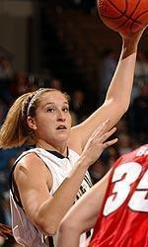
ATP / ADP cycle
Can’t store ATP
    too reactive
    only short term energy storage
      carbohydrates & fats are long term energy storage
ATP
cellular
respiration
7.3
kcal/mole
ADP
+
P_{i}
A working muscle recycles over
10 million ATPs per second

Slide 6
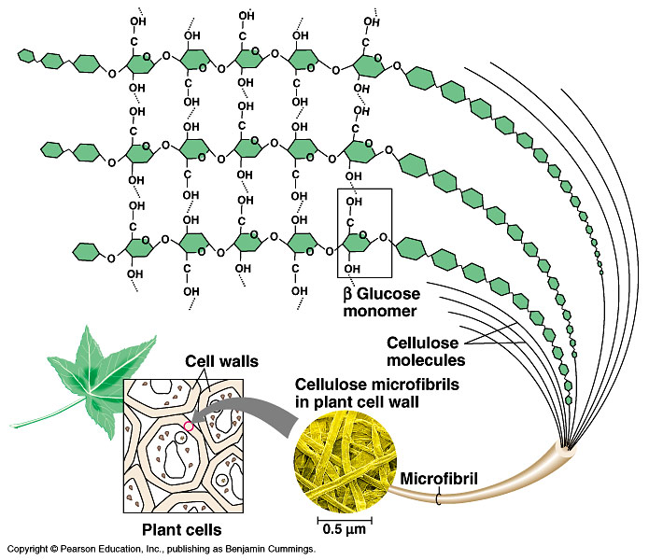
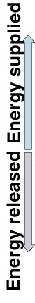
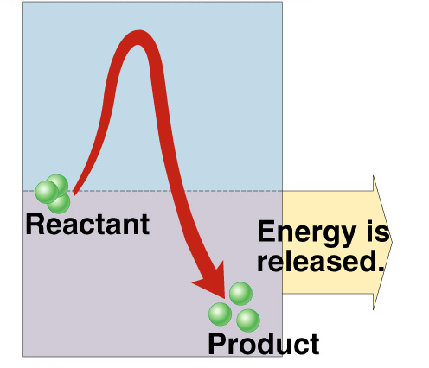
What drives reactions?
If reactions are “downhill”, why don’t they just happen spontaneously?
  because covalent bonds are stable bonds
starch

Slide 7
Activation energy
Breaking down large molecules requires an initial input of energy
  activation energy
cellulose
CO₂ + H₂O + heat
energy
Notes:
Need a spark to start a fire

Slide 8
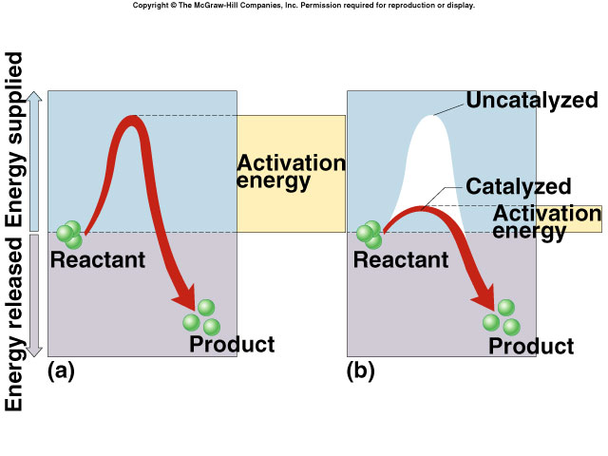
Catalysts
So what’s a cell got to do to reduce activation energy?
  get help! … chemical help…
ENZYMES
Call in the
ENZYMES!
ΔG

Slide 9
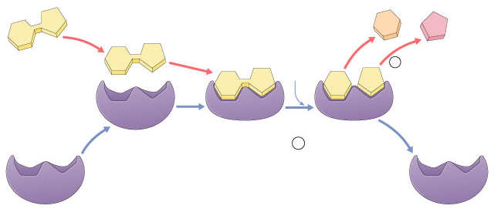
Enzymes
Biological catalysts
  proteins
  required for most biological reactions
  highly specific
    thousands of different enzymes in cells

Slide 10
Enzymes vocabulary
substrate
    reactant which binds to enzyme
product
    end result of reaction
active site
    enzyme’s catalytic site; substrate fits into active site
active site
substrate
products
enzyme

Slide 11
Properties of enzymes
Reaction specific
  each enzyme works with a specific substrate
Not consumed in reaction
  single enzyme molecule can catalyze thousands or more reactions per second
    enzymes unaffected by the reaction
Affected by cellular conditions
  any condition that affects protein structure
    temperature, pH, salinity

Slide 12
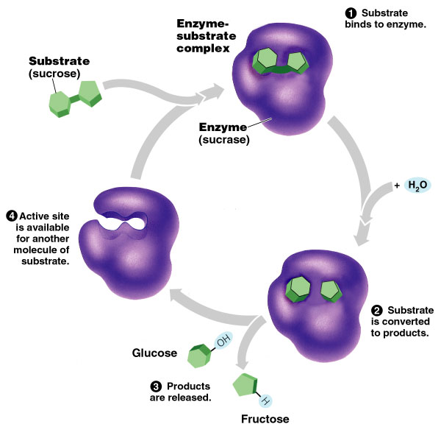
Naming conventions
Enzymes named for reaction they catalyze
  sucrase breaks down sucrose
  proteases break down proteins
  lipases break
  down lipids

Slide 13
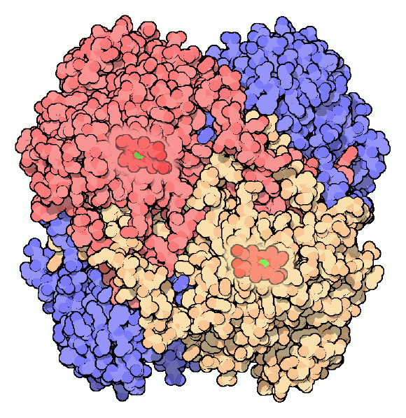
Factors Affecting Enzyme Function
Enzyme concentration
Substrate concentration
Temperature
pH
Salinity
Activators
Inhibitors
catalase
Notes:
Living with oxygen is dangerous. We rely on oxygen to power our cells, but oxygen is a reactive molecule that can cause serious problems if not carefully controlled. One of the dangers of oxygen is that it is easily converted into other reactive compounds. Inside our cells, electrons are continually shuttled from site to site by carrier molecules, such as carriers derived from riboflavin and niacin. If oxygen runs into one of these carrier molecules, the electron may be accidentally transferred to it. This converts oxygen into dangerous compounds such as superoxide radicals and hydrogen peroxide, which can attack the delicate sulfur atoms and metal ions in proteins. To make things even worse, free iron ions in the cell occasionally convert hydrogen peroxide into hydroxyl radicals. These deadly molecules attack and mutate DNA. Fortunately, cells make a variety of antioxidant enzymes to fight the dangerous side-effects of life with oxygen. Two important players are superoxide dismutase, which converts superoxide radicals into hydrogen peroxide, and catalase, which converts hydrogen peroxide into water and oxygen gas. The importance of these enzymes is demonstrated by their prevalence, ranging from about 0.1% of the protein in an E. coli cell to upwards of a quarter of the protein in susceptible cell types. These many catalase molecules patrol the cell, counteracting the steady production of hydrogen peroxide and keeping it at a safe level. Catalases are some of the most efficient enzymes found in cells. Each catalase molecule can decompose millions of hydrogen peroxide molecules every second. The cow catalase shown here and our own catalases use an iron ion to assist in this speedy reaction. The enzyme is composed of four identical subunits, each with its own active site buried deep inside. The iron ion, shown in green, is gripped at the center of a disk-shaped heme group. Catalases, since they must fight against reactive molecules, are also unusually stable enzymes. Notice how the four chains interweave, locking the entire complex into the proper shape.

Slide 14
Factors affecting enzyme function
Enzyme concentration
  as ↑ enzyme = ↑ reaction rate
  reaction rate levels off
    substrate becomes limiting factor
reaction rate
enzyme concentration
Notes:
Why is it a good adaptation to organize the cell in organelles?
Sequester enzymes with their substrates!

Slide 15
Factors affecting enzyme function
Substrate concentration
  as ↑ substrate = ↑ reaction rate
  reaction rate levels off
    all enzymes have active site engaged
    enzyme is saturated
reaction rate
substrate concentration
Notes:
Why is it a good adaptation to organize the cell in organelles?
Sequester enzymes with their substrates!

Slide 16
Factors affecting enzyme function
Temperature
  Optimum T°
    human enzymes = 35°- 40°C
      body temp = 37°C
  Heat: increase beyond optimum T°
    denaturation = lose 3D shape (3° structure)
  Cold: decrease T°
    molecules move slower
    decrease collisions between enzyme & substrate

Slide 17
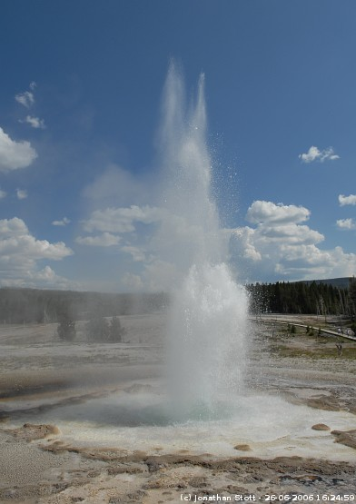
Enzymes and temperature
Different enzymes function in different organisms in different environments
hot spring
bacteria enzyme
human enzyme
reaction rate
37°C
70°C
temperature
(158°F)

Slide 18
Factors affecting enzyme function
pH
  changes in pH
    disrupts bonds, disrupts 3D shape
      denatures protein
  optimal pH?
    most human enzymes = pH 6-8
      depends on localized conditions
      pepsin (stomach) = pH 2-3
0
1
2
3
4
5
6
7
8
9
10
11

Slide 19
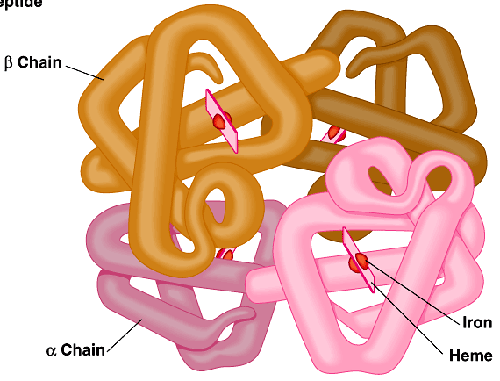
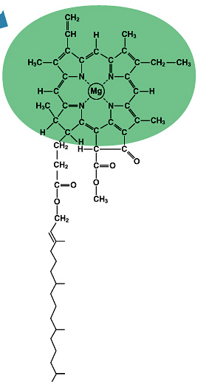
Compounds which help enzymes
Activators
  cofactors
    non-protein, small inorganic compounds & ions
      Mg, K, Ca, Zn, Fe, Cu
      bound within enzyme molecule
  coenzymes
    non-protein, organic molecules
      bind to enzyme near active site
    many vitamins
Fe in
hemoglobin
Mg in
chlorophyll
Notes:
Hemoglobin is aided by Fe
Chlorophyll is aided by Mg

Slide 20
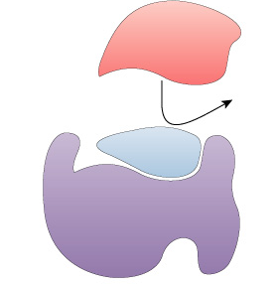
Compounds which regulate enzymes
Inhibitors
  molecules that reduce enzyme activity
  competitive inhibition
  noncompetitive inhibition
  irreversible inhibition
  feedback inhibition

Slide 21
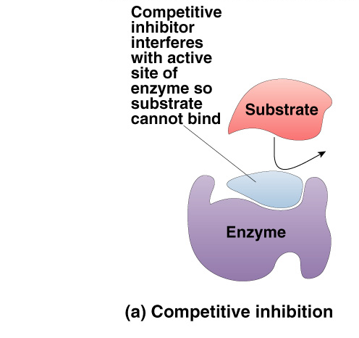
Competitive Inhibitor
Inhibitor & substrate “compete” for active site
  penicillin
  blocks enzyme bacteria use to build cell walls
Notes:
Ethanol is metabolized in the body by oxidation to acetaldehyde, which is in turn further oxidized to acetic acid by aldehyde oxidase enzymes. Normally, the second reaction is rapid so that acetaldehyde does not accumulate in the body.
A drug, disulfiram (Antabuse) inhibits the aldehyde oxidase which causes the accumulation of acetaldehyde with subsequent unpleasant side-effects of nausea and vomiting. This drug is sometimes used to help people overcome the drinking habit.
Methanol (wood alcohol) poisoning occurs because methanol is oxidized to formaldehyde and formic acid which attack the optic nerve causing blindness. Ethanol is given as an antidote for methanol poisoning because ethanol competitively inhibits the oxidation of methanol. Ethanol is oxidized in preference to methanol and consequently, the oxidation of methanol is slowed down so that the toxic by-products do not have a chance to accumulate.

Slide 22
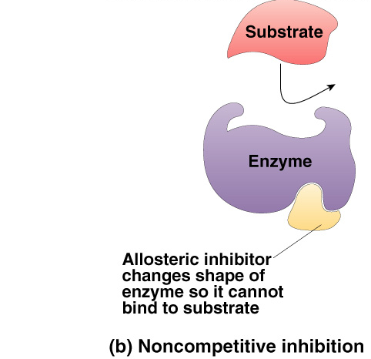
Non-Competitive Inhibitor
Inhibitor binds to site other than active site
  allosteric inhibitor binds to allosteric site
  causes enzyme to change shape
    conformational change
    active site is no longer functional binding site
      keeps enzyme inactive
  cyanide poisoning
  irreversible inhibitor of Cytochrome C,
  an enzyme in cellular respiration
    stops production of ATP
Notes:
Basis of most chemotherapytreatments is enzyme inhibition. Many health disorders can be controlled, in principle, by inhibiting selected enzymes. Two examples include methotrexate and FdUMP, common anticancer drugs which inhibit enzymes involved in the synthesis of thymidine and hence DNA.
Since many enzymes contain sulfhydral (-SH), alcohol, or acid groups as part of their active sites, any chemical which can react with them acts as a noncompetitive inhibitor. Heavy metals such as silver (Ag+), mercury (Hg2+), lead ( Pb2+) have strong affinities for -SH groups.
Cyanide combines with the copper prosthetic groups of the enzyme cytochrome C oxidase, thus inhibiting respiration which causes an organism to run out of ATP (energy)
Oxalic and citric acid inhibit blood clotting by forming complexes with calcium ions necessary for the enzyme metal ion activator.

Slide 23
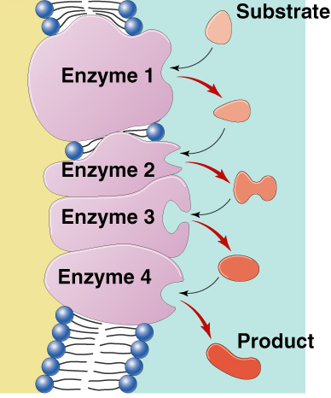
Metabolic pathways
A → B → C → D → E → F → G
A → B → C → D → E → F → G
→
→
→
→
→
→
→
enzyme
1
enzyme
2
enzyme
3
enzyme
4
enzyme
5
enzyme
6
enzyme
Chemical reactions of life
are organized in pathways
  divide chemical reaction into many small steps

Slide 24
Feedback Inhibition
  product is used by next step in pathway
  final product is inhibitor of earlier step
    allosteric inhibitor of earlier enzyme
    feedback inhibition
  no unnecessary accumulation of product
A → B → C → D → E → F → G
→
→
→
→
→
→
X
enzyme
2
enzyme
3
enzyme
4
enzyme
5
enzyme
6
enzyme
1
allosteric inhibitor of enzyme 1

Slide 25
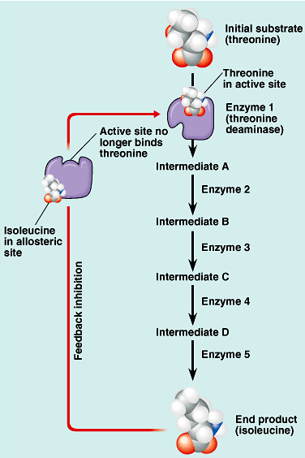
Feedback inhibition
threonine
Example
  synthesis of amino acid, isoleucine from amino acid, threonine
  isoleucine becomes the allosteric inhibitor of the first step in the pathway
    as product accumulates it collides with enzyme more often than substrate does
isoleucine

