Slide 1
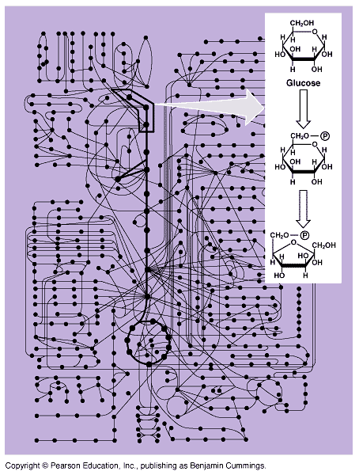
______
Chapter 8~ An Introduction to Metabolism

Slide 2
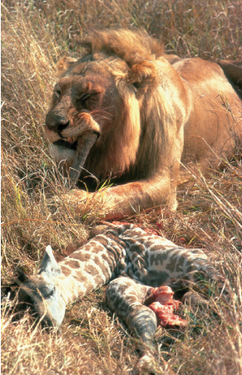
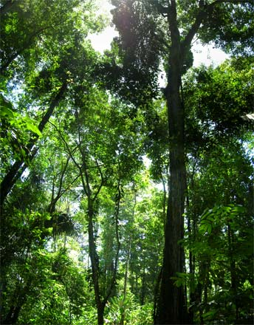
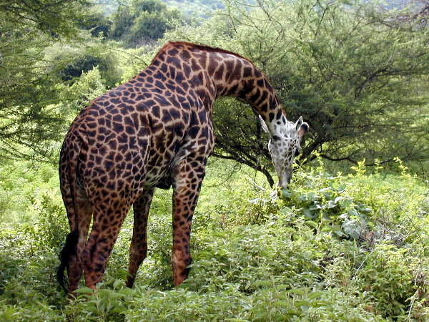
Flow of energy through life
Life is built on chemical reactions
  transforming energy from one form to another
organic molecules → ATP & organic molecules
sun
organic molecules →
ATP & organic molecules
solar energy →
ATP & organic molecules

Slide 3
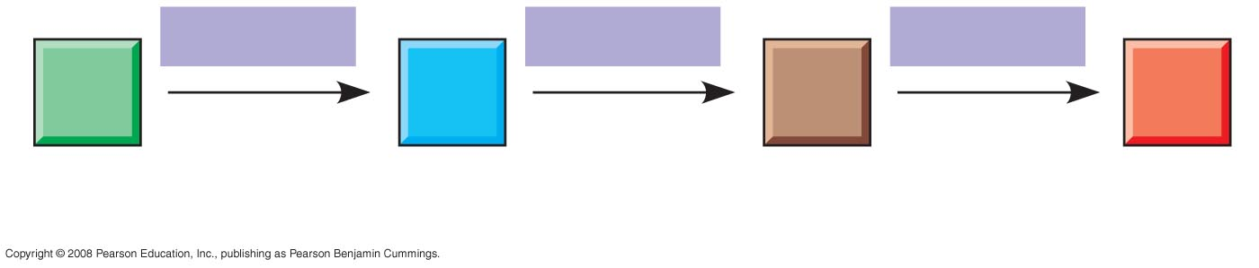
Organization of the Chemistry of Life into Metabolic Pathways
A metabolic pathway begins with a specific molecule and ends with a product
Each step is catalyzed by a specific enzyme
Enzyme 1
Enzyme 2
Enzyme 3
A
C
B
D
Product
Starting
molecule

Slide 4

Metabolism
Chemical reactions of life
  forming bonds between molecules
    dehydration synthesis
    synthesis
    anabolic reactions
  breaking bonds between molecules
    hydrolysis
    digestion
    catabolic reactions
That’s why
they’re called
anabolic steroids!

Slide 5
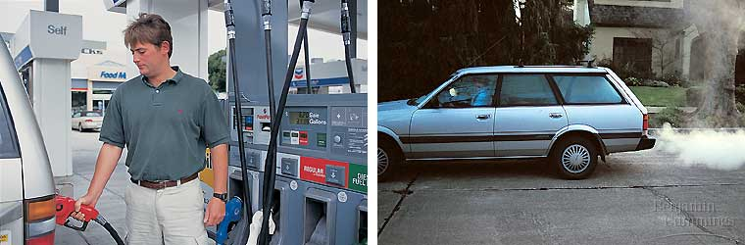
Thermodynamics
Energy (E)~ capacity to do work; Kinetic energy~ energy of motion; Potential energy~ stored energy
Thermodynamics~ study of E transformations
1st Law: conservation of energy; E transferred/transformed, not created/destroyed
2nd Law: transformations increase entropy (disorder, randomness)
Combo: quantity of E is constant, quality is not

Slide 6
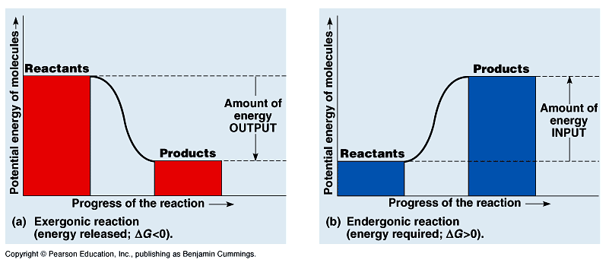
Free energy
Free energy: portion of system’s E that can perform work (at a constant T)
Exergonic reaction: net release of free E to surroundings
Endergonic reaction: absorbs free E from surroundings

Slide 7
Chemical reactions & energy
Some chemical reactions release energy
  exergonic
  digesting polymers
  hydrolysis = catabolism
Some chemical reactions require
input of energy
  endergonic
  building polymers
  dehydration synthesis = anabolism
digesting molecules=
LESS organization=
lower energy state
building molecules=
MORE organization=
higher energy state

Slide 8
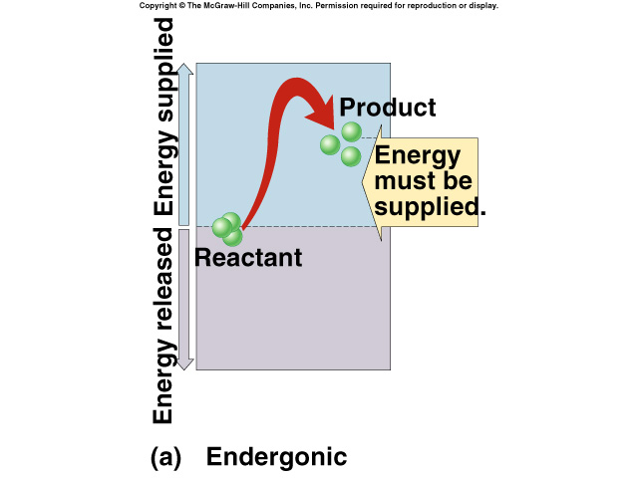
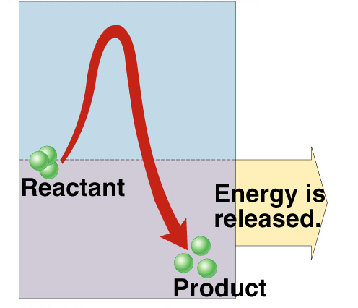
Endergonic vs. exergonic reactions
exergonic
endergonic
- energy released
- digestion
energy invested
synthesis
+ΔG
-ΔG
ΔG = change in free energy = ability to do work

Slide 9

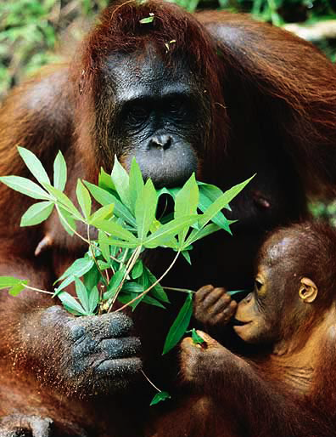
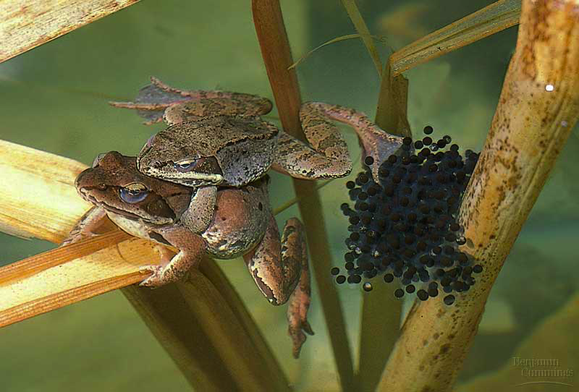
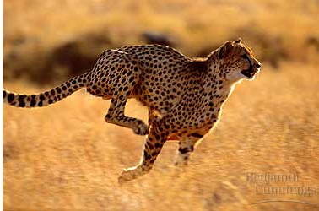
The energy needs of life
Organisms are endergonic systems
  What do we need energy for?
    synthesis
      building biomolecules
    reproduction
    movement
    active transport
    temperature regulation
Notes:
Which is to say… if you don’t eat, you die… because you run out of energy.
The 2nd Law of Thermodynamics takes over!

Slide 10
Where do we get the energy from?
Work of life is done by energy coupling
  use exergonic (catabolic) reactions to fuel endergonic (anabolic) reactions
digestion
energy
+
+
synthesis
energy
+
+

Slide 11

Living economy
Fueling the body’s economy
  eat high energy organic molecules
    food = carbohydrates, lipids, proteins, nucleic acids
  break them down
    digest = catabolism
  capture released energy in a form the cell can use
Need an energy currency
  a way to pass energy around
  need a short term energy
  storage molecule
ATP
Whoa!
Hot stuff!

Slide 12
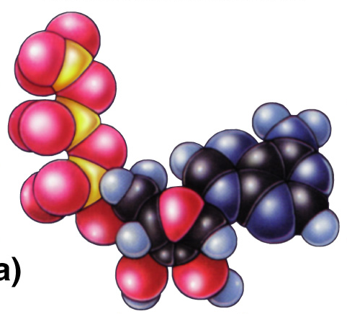
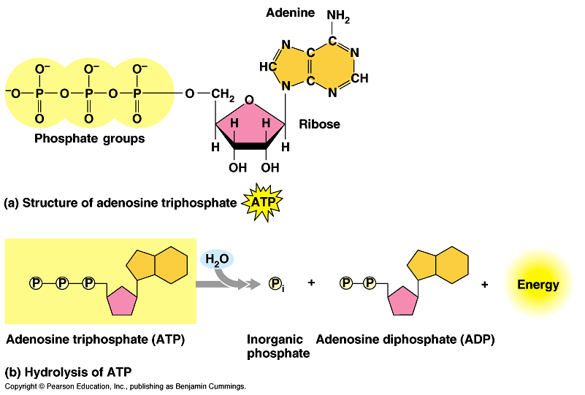
ATP
Adenosine TriPhosphate
  modified nucleotide
    nucleotide =
    adenine + ribose + P_{i} → AMP
    AMP + P_{i} → ADP
    ADP + P_{i} → ATP
  adding phosphates is endergonic
high energy bonds
How efficient!
Build once,
use many ways
Notes:
Marvel at the efficiency of biological systems!
Build once = re-use over and over again.
Start with a nucleotide and add phosphates to it to make this high energy molecule that drives the work of life.
Let’s look at this molecule closer.
Think about putting that Pi on the adenosine-ribose ==>
EXERGONIC or ENDERGONIC?

Slide 13
How does ATP store energy?
I think
he’s a bit
unstable…
don’t you?
O–
O–
O–
O–
P
O–
O–
O–
O–
P
P
P
P
P
P
P
–O
–O
–O
–O
–O
O–
O–
O–
–O
O–
O–
–O
O–
–O
O–
O–
O
O
O
O
AMP
O
O
O
O
ADP
ATP
Each negative PO₄ more difficult to add
  a lot of stored energy in each bond
    most energy stored in 3rd P_{i}
    3rd P_{i} is hardest group to keep bonded to molecule
Bonding of negative P_{i} groups is unstable
  spring-loaded
  P_{i} groups “pop” off easily & release energy
Instability of its P bonds makes ATP an excellent energy donor
Notes:
Not a happy molecule
Add 1st Pi → Kerplunk!
Big negatively charged functional group
Add 2nd Pi → EASY or DIFFICULT to add?
DIFFICULT→ takes energy to add = same charges repel
→ Is it STABLE or UNSTABLE?
UNSTABLE = 2 negatively charged functional groups not strongly bonded to each other
So if it releases Pi → releases ENERGY
Add 3rd Pi → MORE or LESS UNSTABLE?
MORE = like an unstable currency
• Hot stuff!
• Doesn’t stick around
• Can’t store it up
• Dangerous to store = wants to give its Pi to anything

Slide 14
How does ATP transfer energy?
7.3
energy
O–
O–
O–
O–
P
P
P
P
–O
–O
O–
–O
O–
O–
–O
O–
+
ADP
O
O
O
O
ATP
ATP → ADP
  releases energy
    ∆G = -7.3 kcal/mole
Fuel other reactions
Phosphorylation
  released P_{i} can transfer to other molecules
    destabilizing the other molecules
  enzyme that phosphorylates = “kinase”
Notes:
How does ATP transfer energy?
By phosphorylating
Think of the 3rd Pi as the bad boyfriend ATP tries to dump off on someone else = phosphorylating
How does phosphorylating provide energy?
Pi is very electronegative. Got lots of OXYGEN!! OXYGEN is very electronegative. Steals e’s from other atoms in the molecule it is bonded to. As e’s fall to electronegative atom, they release energy.
Makes the other molecule “unhappy” = unstable. Starts looking for a better partner to bond to. Pi is again the bad boyfriend you want to dump.
You’ve got to find someone else to give him away to. You give him away and then bond with someone new that makes you happier (monomers get together).
Eventually the bad boyfriend gets dumped and goes off alone into the cytoplasm as a free agent = free Pi.

Slide 15
An example of Phosphorylation…
H
H
Building polymers from monomers
  need to destabilize the monomers
  phosphorylate!
C
C
OH
HO
enzyme
H
H
synthesis
H
H
+
+
H₂O
C
C
C
C
OH
HO
+4.2 kcal/mol
O
H
“kinase”
enzyme
H
+
It’s
never that
simple!
ATP
ADP
+
C
C
OH
-7.3 kcal/mol
P
H
H
H
H
+
+
P_{i}
C
C
C
C
P
HO
-3.1 kcal/mol
O
Notes:
Monomers → polymers
Not that simple!
H₂O doesn’t just come off on its own
You have to pull it off by phosphorylating monomers.
Polymerization reactions (dehydration synthesis) involve a phosphorylation step!
Where does the P_{i} come from? ATP

Slide 16
Another example of Phosphorylation…
The first steps of cellular respiration
  beginning the breakdown of glucose to make ATP
glucose
C-C-C-C-C-C
Those
phosphates
sure make it
uncomfortable
around here!
P
ATP
2
C
hexokinase
2
C
H
phosphofructokinase
ADP
fructose-1,6bP
P-C-C-C-C-C-C-P
C
P
DHAP
P-C-C-C
G3P
C-C-C-P
activation
energy
Notes:
These are the very first steps in respiration — making ATP from glucose.
Fructose-1,6-bisphosphate (F1,6bP)
Dihydroxyacetone phosphate (DHAP)
Glyceraldehyde-3-phosphate (G3P)
1st ATP used is like a match to light a fire…
initiation energy / activation energy.
The Pi makes destabilizes the glucose & gets it ready to split.

Slide 17
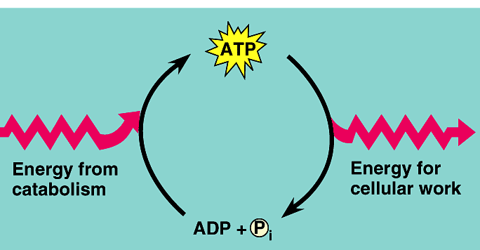
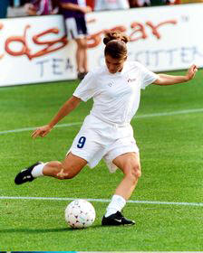
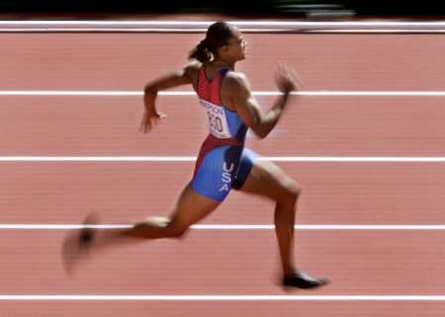
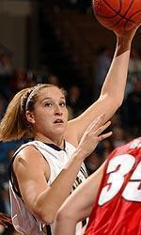
ATP / ADP cycle
Can’t store ATP
  good energy donor,
  not good energy storage
    too reactive
    transfers P_{i} too easily
    only short term energy storage
      carbohydrates & fats are long term energy storage
ATP
cellular
respiration
7.3
kcal/mole
ADP
+
P_{i}
A working muscle recycles over
10 million ATPs per second
Whoa!
Pass me
the glucose
(and O₂)!

Slide 18
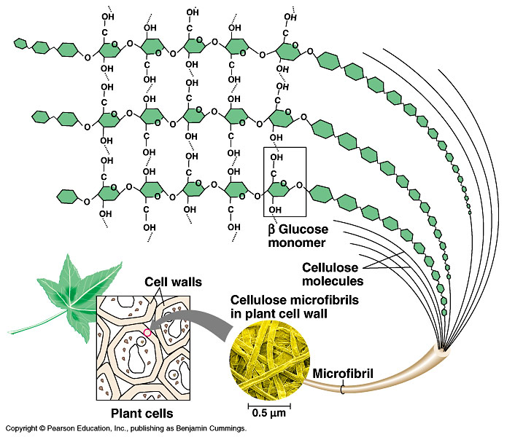
What drives reactions?
If reactions are “downhill”, why don’t they just happen spontaneously?
  because covalent bonds are stable bonds
Why don’t
stable polymers
spontaneously
digest into their
monomers?
starch

Slide 19
Activation energy
Breaking down large molecules requires an initial input of energy
  activation energy
  large biomolecules are stable
  must absorb energy to break bonds
cellulose
CO₂ + H₂O + heat
energy
Notes:
Need a spark to start a fire

Slide 20
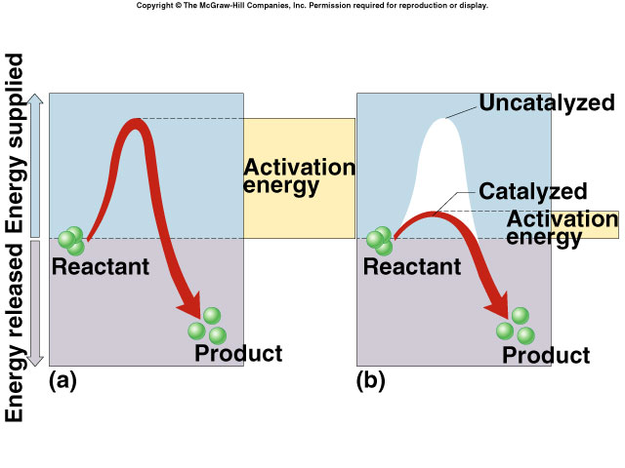
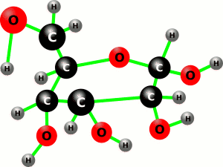
Too much activation energy for life
Activation energy
  amount of energy needed to destabilize the bonds of a molecule
  moves the reaction over an “energy hill”
Not a match!
That’s too much
energy to expose
living cells to!
glucose
Notes:
2nd Law of thermodynamics
Universe tends to disorder
so why don’t proteins, carbohydrates & other biomolecules breakdown?
at temperatures typical of the cell, molecules don’t make it over the hump of activation energy
but, a cell must be metabolically active
heat would speed reactions, but…
would denature proteins & kill cells

Slide 21
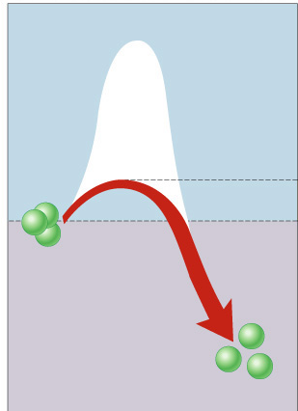
Reducing Activation energy
Catalysts
  reducing the amount of energy to
  start a reaction
Pheeew…
that takes a lot
less energy!
uncatalyzed reaction
catalyzed reaction
NEW activation energy
reactant
product

Slide 22
Catalysts
So what’s a cell got to do to reduce activation energy?
  get help! … chemical help…
ENZYMES
Call in the
ENZYMES!
ΔG

Slide 23
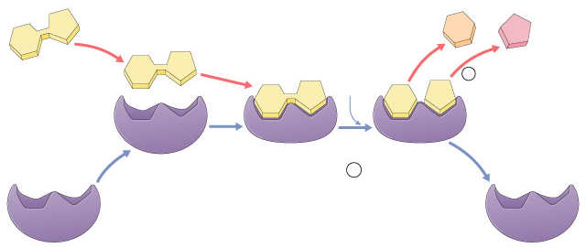
Enzymes
Biological catalysts
  proteins (& RNA)
  facilitate chemical reactions
    increase rate of reaction without being consumed
    reduce activation energy
    don’t change free energy (ΔG) released or required
  required for most biological reactions
  highly specific
    thousands of different enzymes in cells
  control reactions
  of life

Slide 24
Enzymes vocabulary
substrate
    reactant which binds to enzyme
    enzyme-substrate complex: temporary association
product
    end result of reaction
active site
    enzyme’s catalytic site; substrate fits into active site
active site
substrate
products
enzyme

Slide 25
Properties of enzymes
Reaction specific
  each enzyme works with a specific substrate
    chemical fit between active site & substrate
      H bonds & ionic bonds
Not consumed in reaction
  single enzyme molecule can catalyze thousands or more reactions per second
    enzymes unaffected by the reaction
Affected by cellular conditions
  any condition that affects protein structure
    temperature, pH, salinity

Slide 26
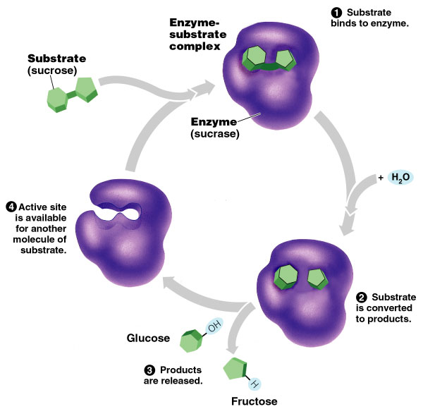
Naming conventions
Enzymes named for reaction they catalyze
  sucrase breaks down sucrose
  proteases break down proteins
  lipases break
  down lipids
  DNA polymerase builds DNA
    adds nucleotides
    to DNA strand
  pepsin breaks down
  proteins (polypeptides)

Slide 27
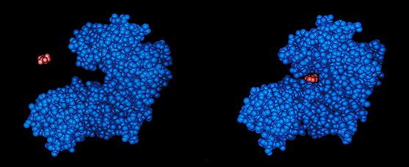
Lock and Key model
Simplistic model of enzyme action
  substrate fits into 3-D structure of enzyme’ active site
    H bonds between substrate & enzyme
  like “key fits into lock”
In biology…
Size
doesn’t matter…
Shape matters!

Slide 28
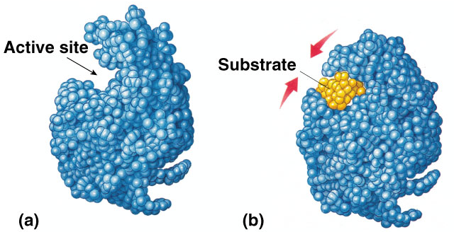
Induced fit model
More accurate model of enzyme action
  3-D structure of enzyme fits substrate
  substrate binding cause enzyme to change shape leading to a tighter fit
    “conformational change”
    bring chemical groups in position to catalyze reaction

Slide 29
How does it work?
Variety of mechanisms to lower activation energy & speed up reaction
  synthesis
    active site orients substrates in correct position for reaction
      enzyme brings substrate closer together
  digestion
    active site binds substrate & puts stress on bonds that must be broken, making it easier to separate molecules

Slide 30
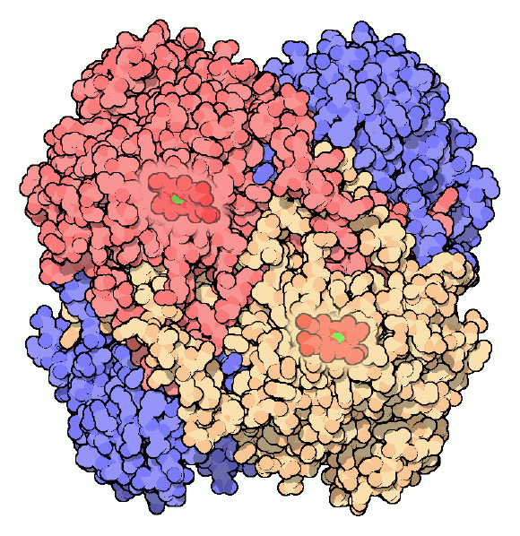
Factors Affecting Enzyme Function
Enzyme concentration
Substrate concentration
Temperature
pH
Salinity
Activators
Inhibitors
catalase
Notes:
Living with oxygen is dangerous. We rely on oxygen to power our cells, but oxygen is a reactive molecule that can cause serious problems if not carefully controlled. One of the dangers of oxygen is that it is easily converted into other reactive compounds. Inside our cells, electrons are continually shuttled from site to site by carrier molecules, such as carriers derived from riboflavin and niacin. If oxygen runs into one of these carrier molecules, the electron may be accidentally transferred to it. This converts oxygen into dangerous compounds such as superoxide radicals and hydrogen peroxide, which can attack the delicate sulfur atoms and metal ions in proteins. To make things even worse, free iron ions in the cell occasionally convert hydrogen peroxide into hydroxyl radicals. These deadly molecules attack and mutate DNA. Fortunately, cells make a variety of antioxidant enzymes to fight the dangerous side-effects of life with oxygen. Two important players are superoxide dismutase, which converts superoxide radicals into hydrogen peroxide, and catalase, which converts hydrogen peroxide into water and oxygen gas. The importance of these enzymes is demonstrated by their prevalence, ranging from about 0.1% of the protein in an E. coli cell to upwards of a quarter of the protein in susceptible cell types. These many catalase molecules patrol the cell, counteracting the steady production of hydrogen peroxide and keeping it at a safe level. Catalases are some of the most efficient enzymes found in cells. Each catalase molecule can decompose millions of hydrogen peroxide molecules every second. The cow catalase shown here and our own catalases use an iron ion to assist in this speedy reaction. The enzyme is composed of four identical subunits, each with its own active site buried deep inside. The iron ion, shown in green, is gripped at the center of a disk-shaped heme group. Catalases, since they must fight against reactive molecules, are also unusually stable enzymes. Notice how the four chains interweave, locking the entire complex into the proper shape.

Slide 31
Factors affecting enzyme function
Enzyme concentration
  as ↑ enzyme = ↑ reaction rate
    more enzymes = more frequently collide with substrate
  reaction rate levels off
    substrate becomes limiting factor
    not all enzyme molecules can find substrate
reaction rate
enzyme concentration
Notes:
Why is it a good adaptation to organize the cell in organelles?
Sequester enzymes with their substrates!

Slide 32
Factors affecting enzyme function
Substrate concentration
  as ↑ substrate = ↑ reaction rate
    more substrate = more frequently collide with enzyme
  reaction rate levels off
    all enzymes have active site engaged
    enzyme is saturated
    maximum rate of reaction
reaction rate
substrate concentration
Notes:
Why is it a good adaptation to organize the cell in organelles?
Sequester enzymes with their substrates!

Slide 33
Factors affecting enzyme function
Temperature
  Optimum T°
    greatest number of molecular collisions
    human enzymes = 35°- 40°C
      body temp = 37°C
  Heat: increase beyond optimum T°
    increased energy level of molecules disrupts bonds in enzyme & between enzyme & substrate
      H, ionic = weak bonds
    denaturation = lose 3D shape (3° structure)
  Cold: decrease T°
    molecules move slower
    decrease collisions between enzyme & substrate

Slide 34
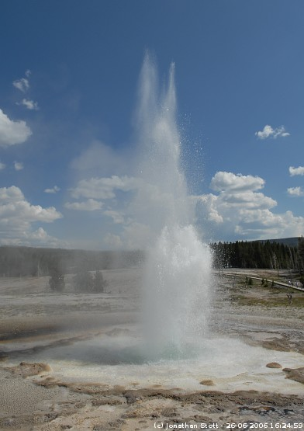
Enzymes and temperature
Different enzymes function in different organisms in different environments
hot spring
bacteria enzyme
human enzyme
reaction rate
37°C
70°C
temperature
(158°F)

Slide 35
Factors affecting enzyme function
pH
  changes in pH
    adds or remove H⁺
    disrupts bonds, disrupts 3D shape
      disrupts attractions between charged amino acids
      affect 2° & 3° structure
      denatures protein
  optimal pH?
    most human enzymes = pH 6-8
      depends on localized conditions
      pepsin (stomach) = pH 2-3
      trypsin (small intestines) = pH 8
0
1
2
3
4
5
6
7
8
9
10
11

Slide 36
Factors affecting enzyme function
Salt concentration
  changes in salinity
    adds or removes cations (+) & anions (–)
    disrupts bonds, disrupts 3D shape
      disrupts attractions between charged amino acids
      affect 2° & 3° structure
      denatures protein
  enzymes intolerant of extreme salinity
    Dead Sea is called dead for a reason!

Slide 37
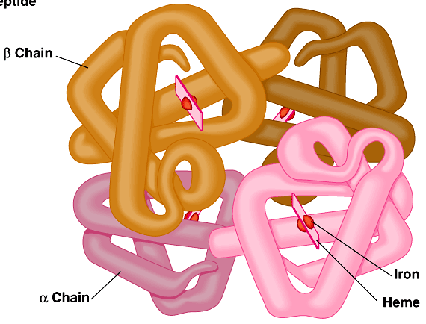
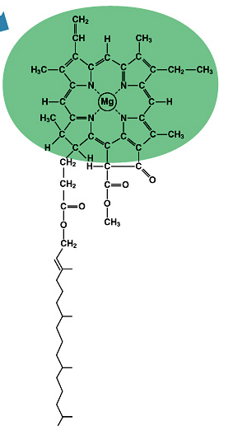
Compounds which help enzymes
Activators
  cofactors
    non-protein, small inorganic compounds & ions
      Mg, K, Ca, Zn, Fe, Cu
      bound within enzyme molecule
  coenzymes
    non-protein, organic molecules
      bind temporarily or permanently to
      enzyme near active site
    many vitamins
    NAD (niacin; B3)
      FAD (riboflavin; B2)
      Coenzyme A
Fe in
hemoglobin
Mg in
chlorophyll
Notes:
Hemoglobin is aided by Fe
Chlorophyll is aided by Mg

Slide 38
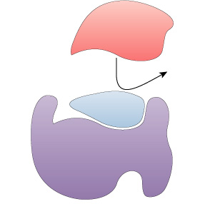
Compounds which regulate enzymes
Inhibitors
  molecules that reduce enzyme activity
  competitive inhibition
  noncompetitive inhibition
  irreversible inhibition
  feedback inhibition

Slide 39
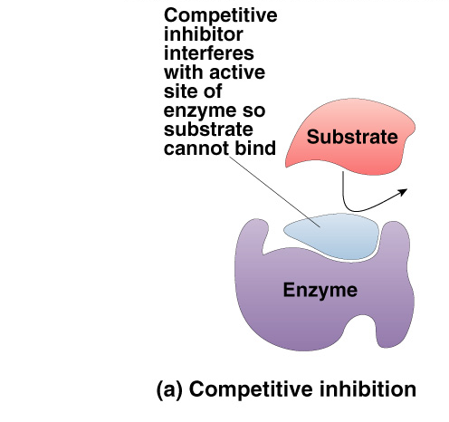
Competitive Inhibitor
Inhibitor & substrate “compete” for active site
  penicillin
  blocks enzyme bacteria use to build cell walls
  disulfiram (Antabuse)
  treats chronic alcoholism
    blocks enzyme that
    breaks down alcohol
    severe hangover & vomiting
    5-10 minutes after drinking
Overcome by increasing substrate
concentration
  saturate solution with substrate
  so it out-competes inhibitor
  for active site on enzyme
Notes:
Ethanol is metabolized in the body by oxidation to acetaldehyde, which is in turn further oxidized to acetic acid by aldehyde oxidase enzymes. Normally, the second reaction is rapid so that acetaldehyde does not accumulate in the body.
A drug, disulfiram (Antabuse) inhibits the aldehyde oxidase which causes the accumulation of acetaldehyde with subsequent unpleasant side-effects of nausea and vomiting. This drug is sometimes used to help people overcome the drinking habit.
Methanol (wood alcohol) poisoning occurs because methanol is oxidized to formaldehyde and formic acid which attack the optic nerve causing blindness. Ethanol is given as an antidote for methanol poisoning because ethanol competitively inhibits the oxidation of methanol. Ethanol is oxidized in preference to methanol and consequently, the oxidation of methanol is slowed down so that the toxic by-products do not have a chance to accumulate.

Slide 40
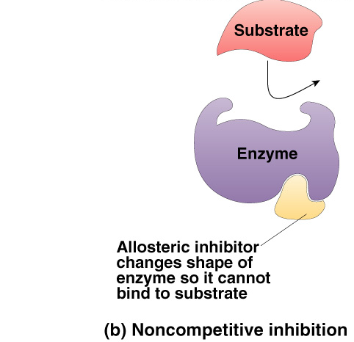
Non-Competitive Inhibitor
Inhibitor binds to site other than active site
  allosteric inhibitor binds to allosteric site
  causes enzyme to change shape
    conformational change
    active site is no longer functional binding site
      keeps enzyme inactive
  some anti-cancer drugs
  inhibit enzymes involved in DNA synthesis
    stop DNA production
    stop division of more cancer cells
  cyanide poisoning
  irreversible inhibitor of Cytochrome C,
  an enzyme in cellular respiration
    stops production of ATP
Notes:
Basis of most chemotherapytreatments is enzyme inhibition. Many health disorders can be controlled, in principle, by inhibiting selected enzymes. Two examples include methotrexate and FdUMP, common anticancer drugs which inhibit enzymes involved in the synthesis of thymidine and hence DNA.
Since many enzymes contain sulfhydral (-SH), alcohol, or acid groups as part of their active sites, any chemical which can react with them acts as a noncompetitive inhibitor. Heavy metals such as silver (Ag+), mercury (Hg2+), lead ( Pb2+) have strong affinities for -SH groups.
Cyanide combines with the copper prosthetic groups of the enzyme cytochrome C oxidase, thus inhibiting respiration which causes an organism to run out of ATP (energy)
Oxalic and citric acid inhibit blood clotting by forming complexes with calcium ions necessary for the enzyme metal ion activator.

Slide 41
Irreversible inhibition
Inhibitor permanently binds to enzyme
  competitor
    permanently binds to active site
  allosteric
    permanently binds to allosteric site
    permanently changes shape of enzyme
    nerve gas, sarin, many insecticides (malathion, parathion…)
      cholinesterase inhibitors
        doesn’t breakdown the neurotransmitter, acetylcholine
Notes:
Another example of irreversible inhibition is provided by the nerve gas diisopropylfluorophosphate (DFP) designed for use in warfare. It combines with the amino acid serine (contains the –SH group) at the active site of the enzyme acetylcholinesterase. The enzyme deactivates the neurotransmitter acetylcholine.
Neurotransmitters are needed to continue the passage of nerve impulses from one neurone to another across the synapse. Once the impulse has been transmitted, acetylcholinesterase functions to deactivate the acetycholine almost immediately by breaking it down. If the enzyme is inhibited, acetylcholine accumulates and nerve impulses cannot be stopped, causing prolonged muscle contration. Paralysis occurs and death may result since the respiratory muscles are affected.
Some insecticides currently in use, including those known as organophosphates (e.g. parathion), have a similar effect on insects, and can also cause harm to nervous and muscular system of humans who are overexposed to them.

Slide 42
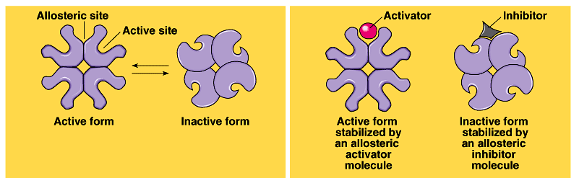
Allosteric regulation
Conformational changes by regulatory molecules
  inhibitors
    keeps enzyme in inactive form
  activators
    keeps enzyme in active form
Conformational changes
Allosteric regulation

Slide 43
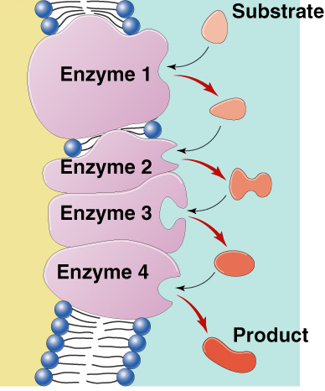
Metabolic pathways
A → B → C → D → E → F → G
A → B → C → D → E → F → G
→
→
→
→
→
→
→
enzyme
1
enzyme
2
enzyme
3
enzyme
4
enzyme
5
enzyme
6
enzyme
Chemical reactions of life
are organized in pathways
  divide chemical reaction into many small steps
    artifact of evolution
    ↑ efficiency
      intermediate branching points
    ↑ control = regulation

Slide 44
Feedback Inhibition
Regulation & coordination of production
  product is used by next step in pathway
  final product is inhibitor of earlier step
    allosteric inhibitor of earlier enzyme
    feedback inhibition
  no unnecessary accumulation of product
A → B → C → D → E → F → G
→
→
→
→
→
→
X
enzyme
2
enzyme
3
enzyme
4
enzyme
5
enzyme
6
enzyme
1
allosteric inhibitor of enzyme 1

Slide 45
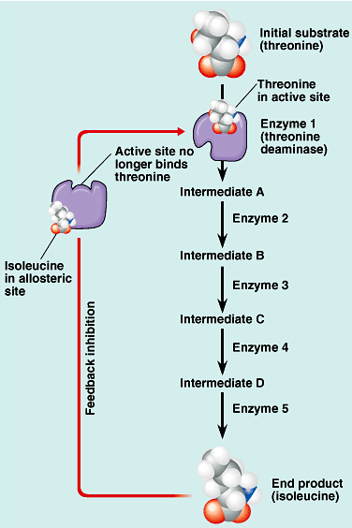
Feedback inhibition
threonine
Example
  synthesis of amino acid, isoleucine from amino acid, threonine
  isoleucine becomes the allosteric inhibitor of the first step in the pathway
    as product accumulates it collides with enzyme more often than substrate does
isoleucine

Slide 46
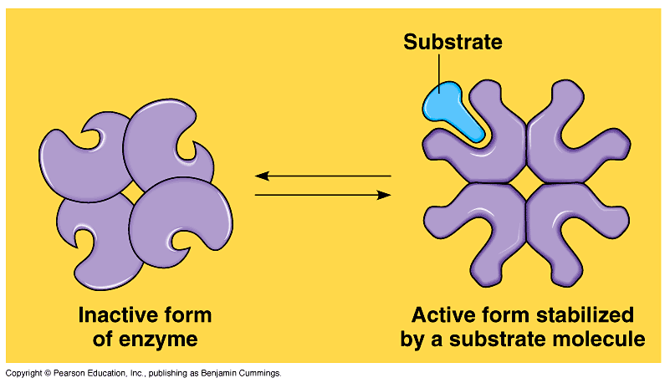
Cooperativity
Substrate acts as an activator
  substrate causes conformational
  change in enzyme
    induced fit
  favors binding of substrate at 2nd site
  makes enzyme more active & effective
    hemoglobin
Hemoglobin
4 polypeptide chains
can bind 4 O₂;
1st O₂ binds
now easier for other 3 O₂ to bind

